Slide 1


Rescue Me
Customer Pack

Slide 2
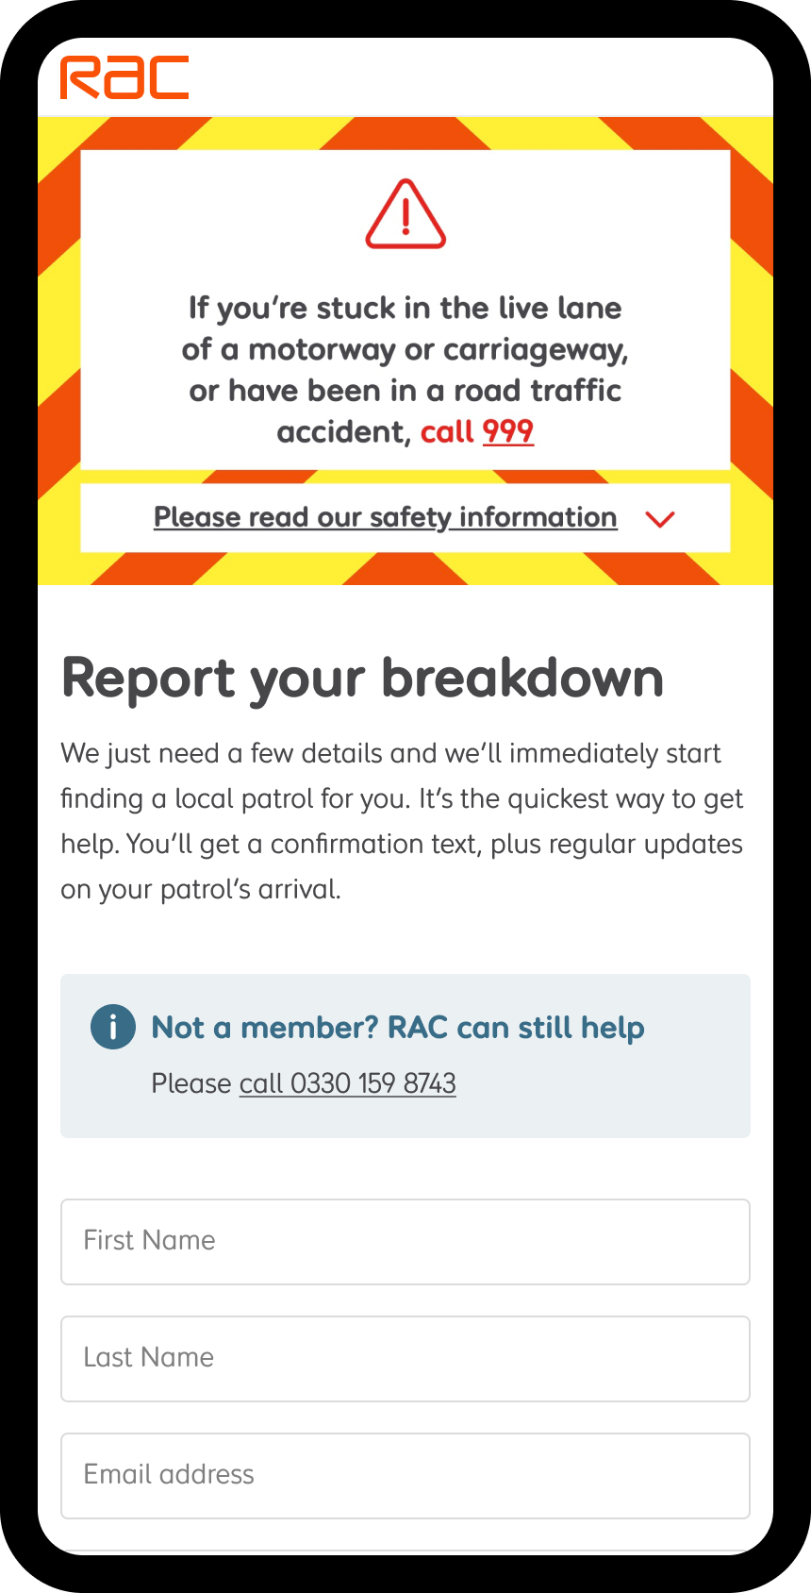
What is Rescue Me?
Background
We've created a digital solution for customers to report a breakdown by delivering a new dedicated section of our existing website https://www.rac.co.uk/reportbreakdown
Rescue Me has become the fastest and most efficient way to report a breakdown to the RAC.
Benefits
Customer can easily and accurately log a breakdown online via their mobile phone
Removes verbally spoken issues – such as noisy environment at the roadside and understanding of different accents
Increases location accuracy by using the phones' location information to avoid having to describe unfamiliar locations
Increased customer satisfaction – currently averaging c.5points higher NPS
All breakdowns continue to be reported to you as our corporate partner

Slide 3
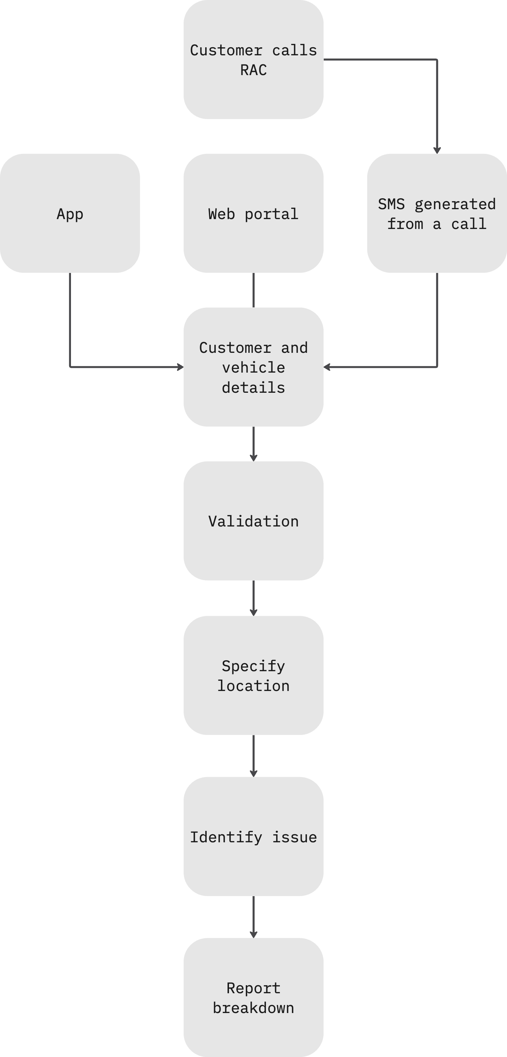
How it Works – Customer Journey
Member will hear an IVR message telling them of an alternative method to report a breakdown and a website address to go to
The member can choose to stay on the existing phone journey or choose to use the digital channel
A text message is sent to the customer containing the URL link if they choose the digital channel option
The form can validate your membership, location, problem with your vehicle and provide helpful advice depending on your chosen symptom
All outbound member updates remain part of the existing customer journey, with customers receiving updates via the phone and text messaging service as appropriate
If a member experiences any issues during the digital journey, they can choose a dedicated voice route back into the contact centre
If the member wishes to use this service again, they can head to www.rac.co.uk/reportbreakdown without ever needing to phone us.

Slide 4
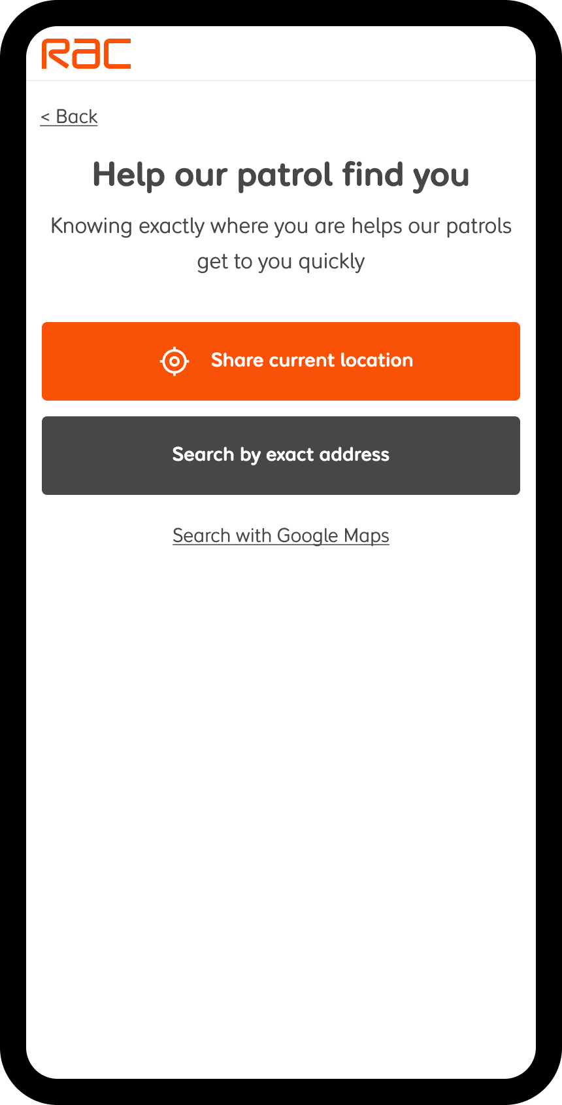
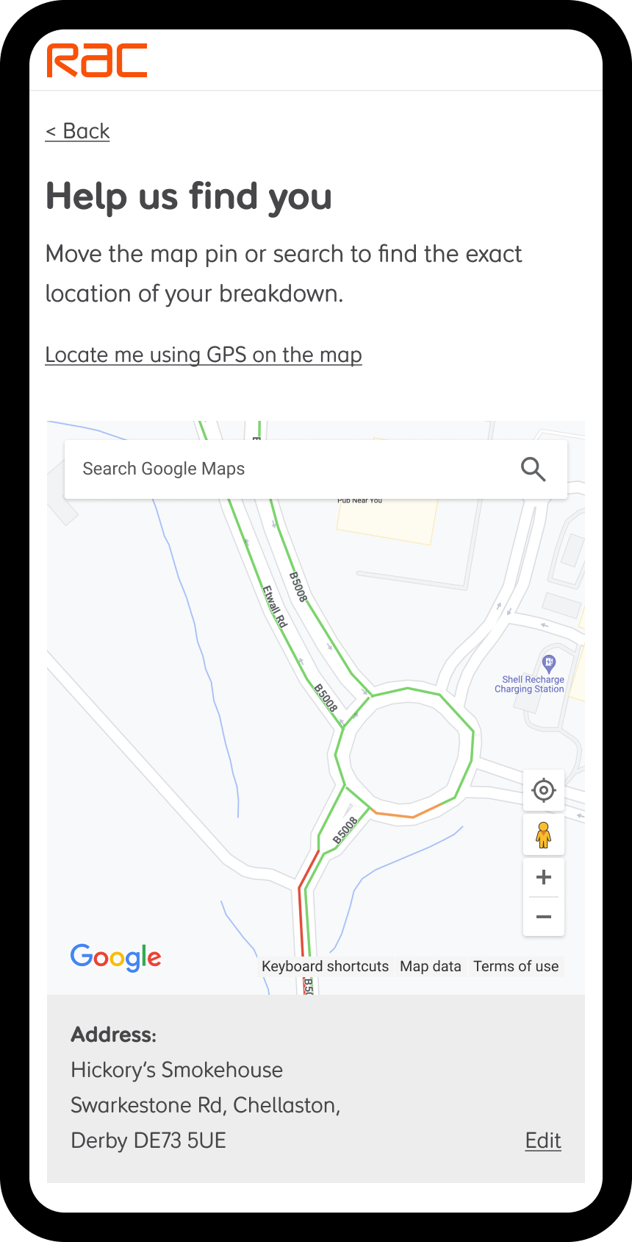
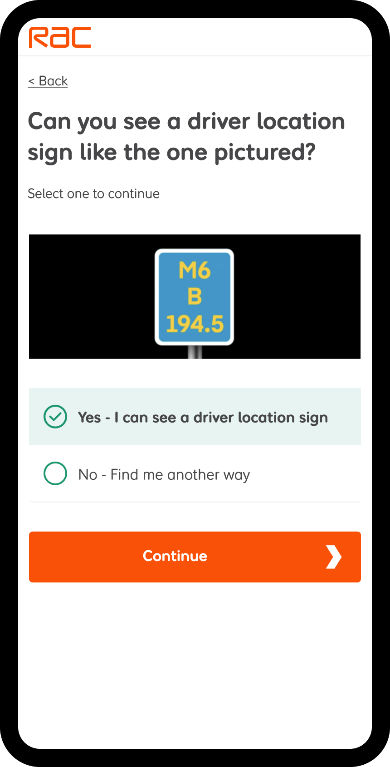
How it Works – Location
Search by exact address, using the address look up.
Use GPS location services or drag and drop on the map.
Input driver location sign info for easier location on motorways and high-speed roads.

Slide 5
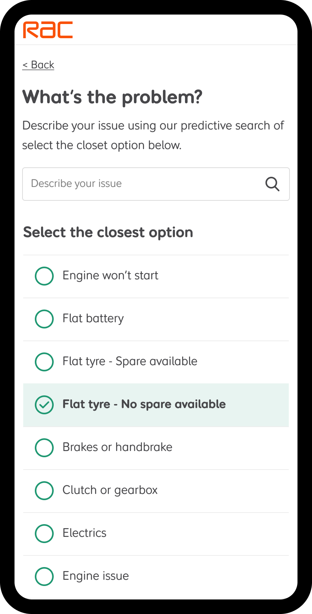
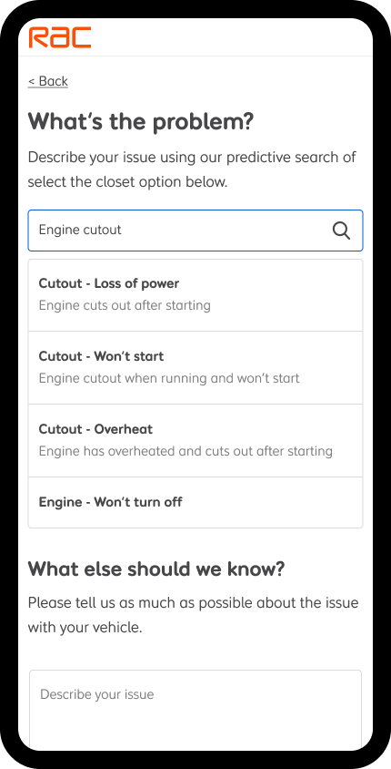
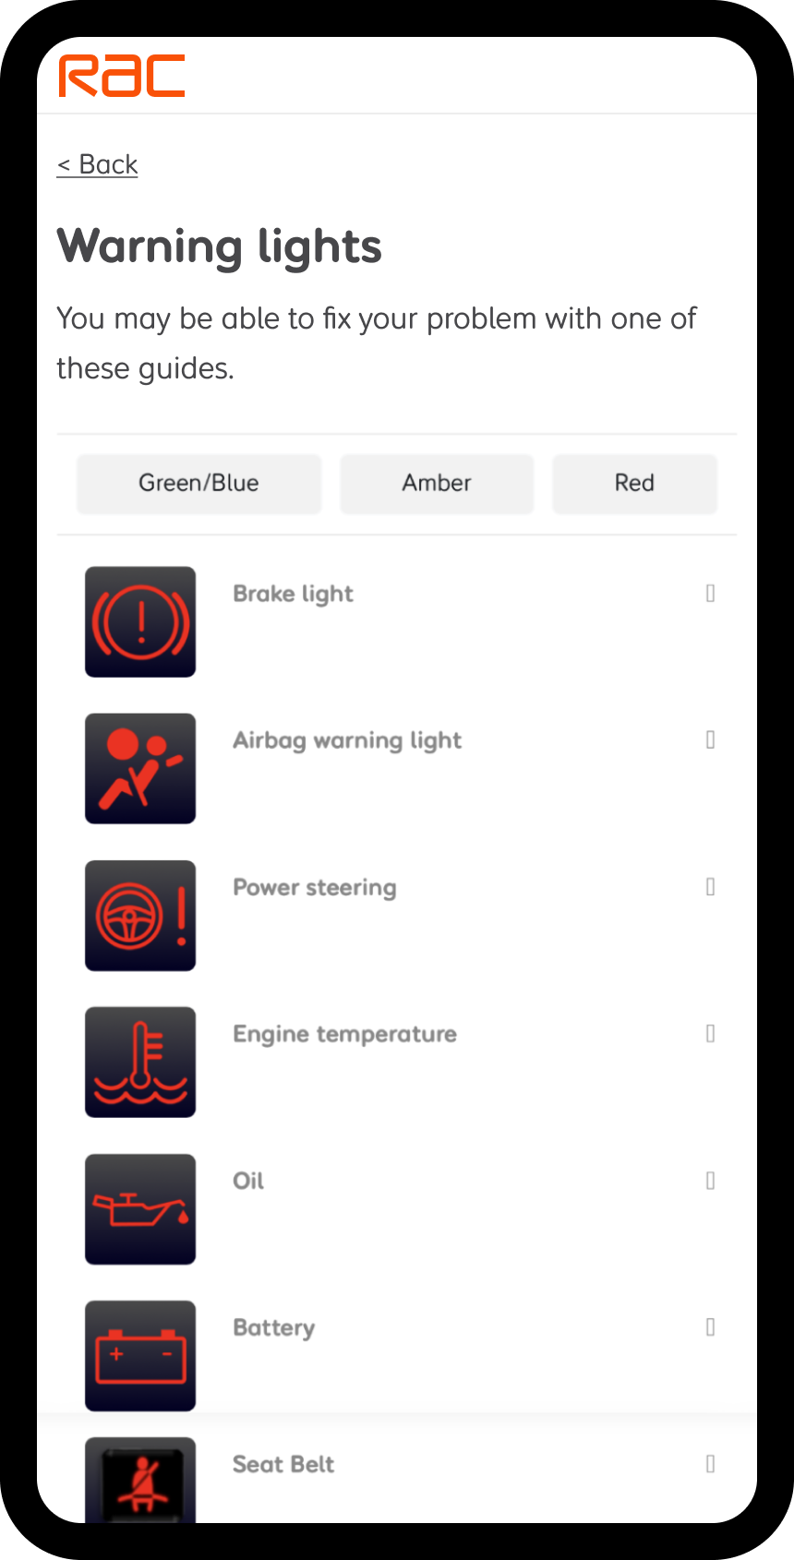
How it Works – Symptom Selection
Find the most frequently selected breakdown symptoms, quickly and easily.
Search for more specific issues with a short description to help explain the symptom.
Self-diagnose common issues for vehicle warning lights.
Notes:
Note - Symptom search is coming soon, expected Jan-Feb 24

Slide 6
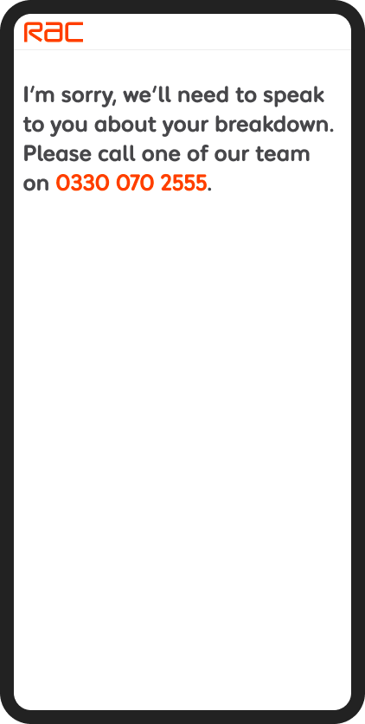
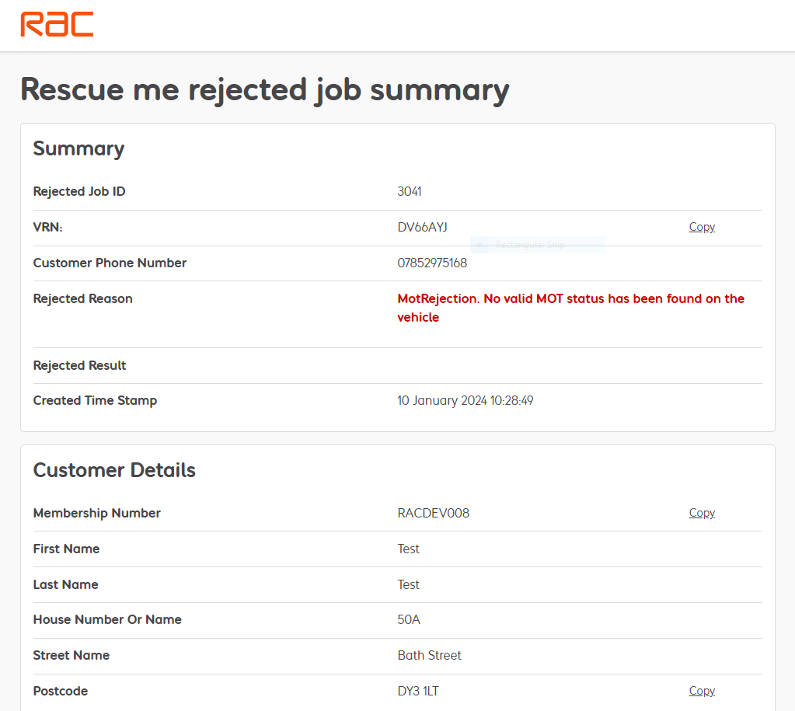
How it Works – Handling Issues
Deflection / Rejection
If a customer has an issue whilst using Rescue Me, we show a specific error message related to that issue, with a high priority phone number they can call.
All the information entered by the customer is available for the RAC contact centre staff to view whilst on the call, so they can continue to help with all the previously entered information.

Slide 7
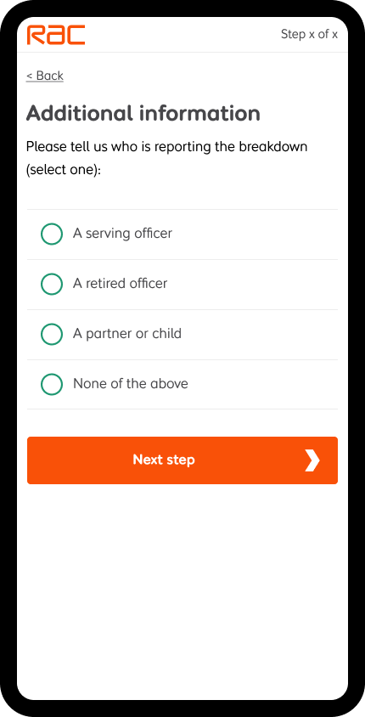
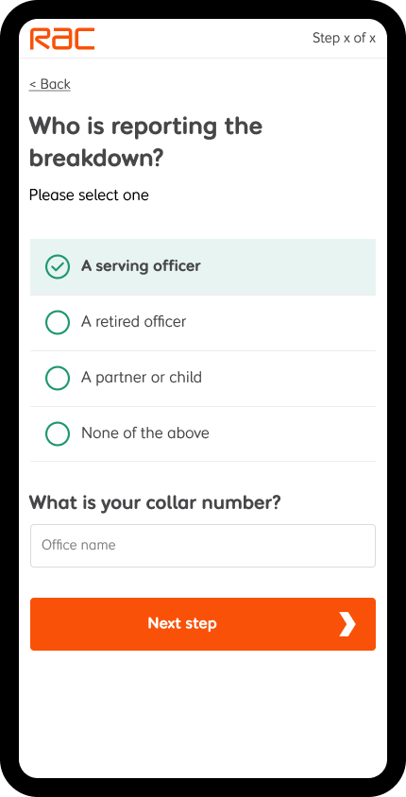
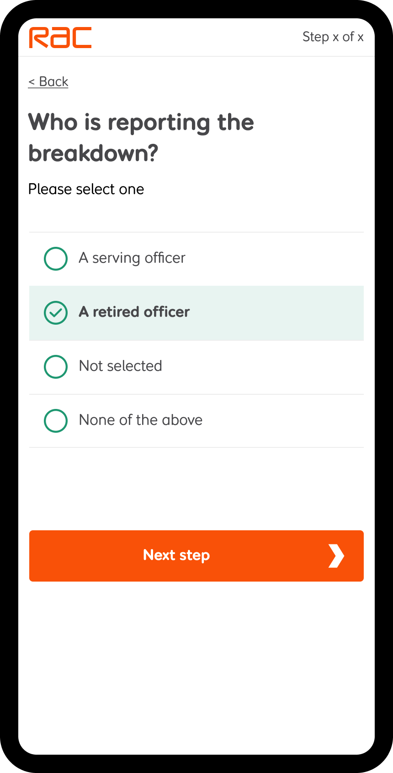
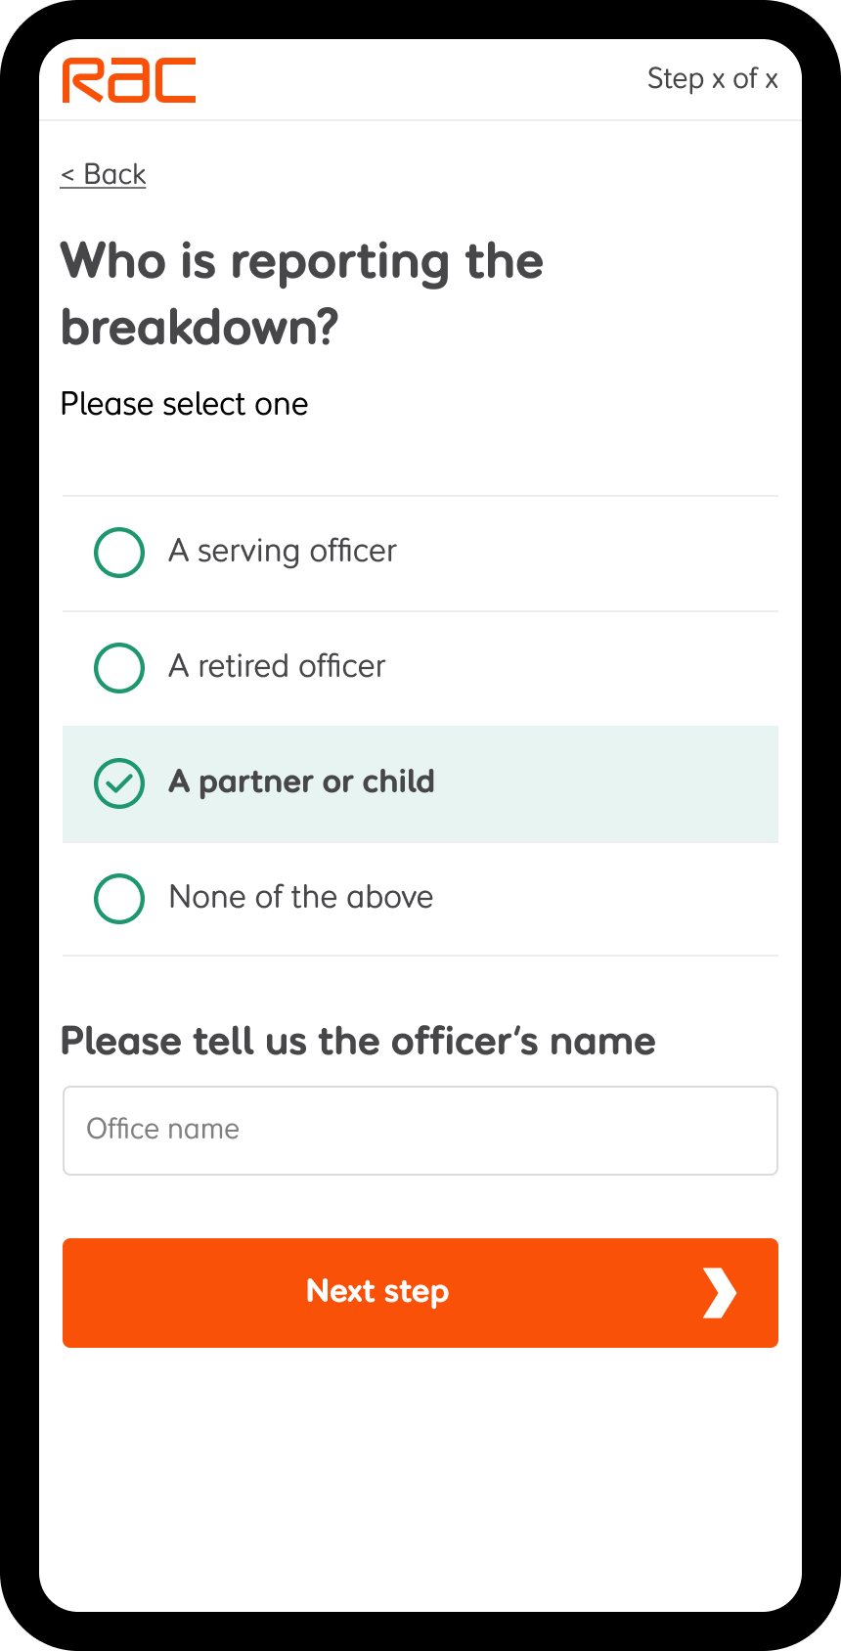
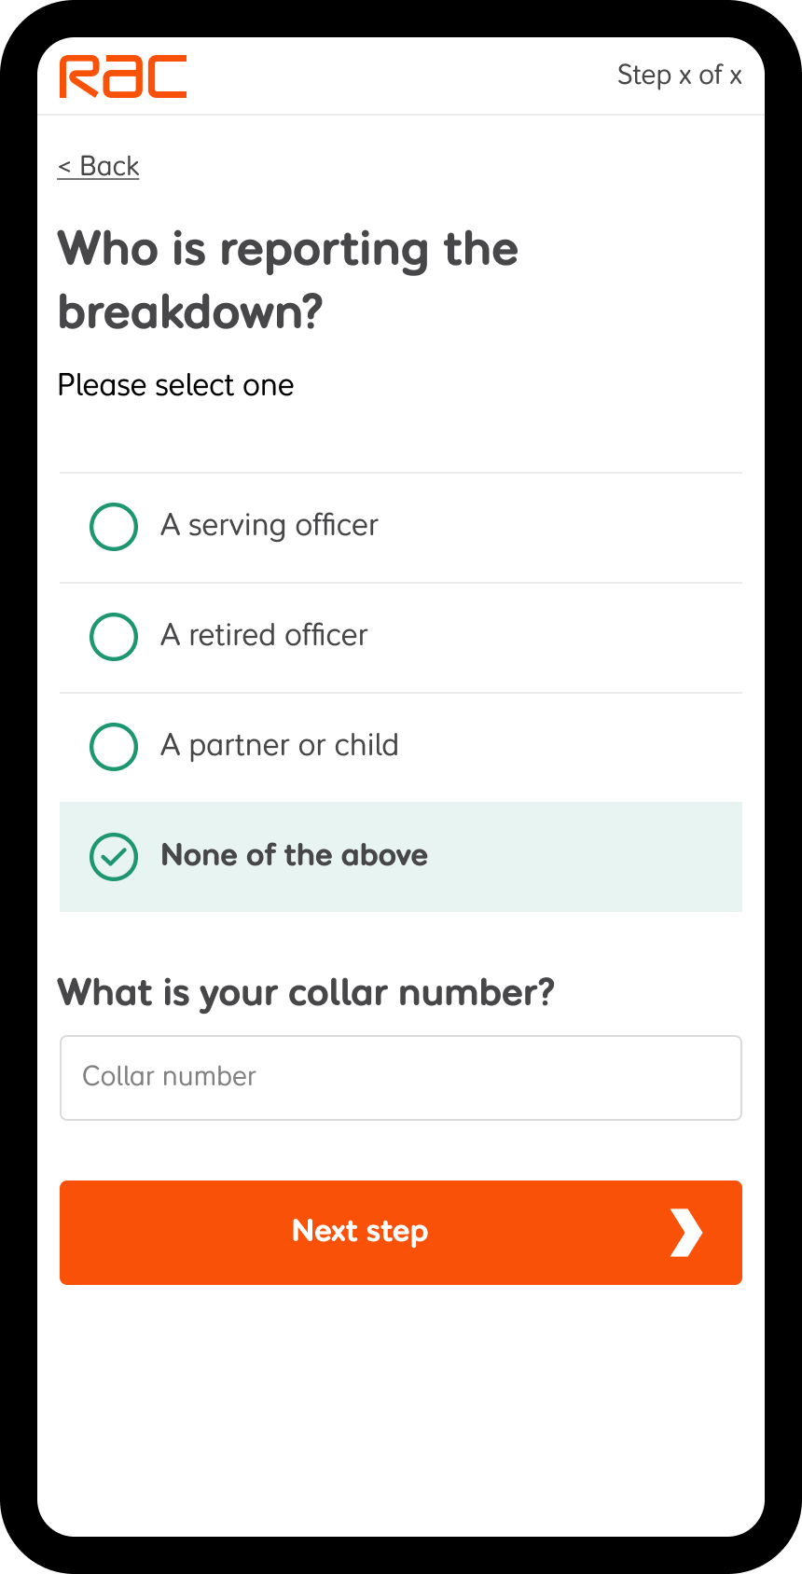
George Burrows Journey
Before the member submits a breakdown, we will ask the following additional information around who is reporting the breakdown.
A serving officer - Collar number
A retired officer – Record retired note
A partner or child – Officer’s name
None of the above – Refuse the breakdown and deflect to the RAC contact centre

Slide 8
Frequently Asked Questions
What happens if a customer doesn’t validate or experiences an error?
If the customer has any issue while going through the digital journey there is a dedicated contact number to call back into the RAC where one of our trained call takers will provide assistance.
Can Rescue Me identify different makes and models of vehicles?
Yes - The digital breakdown channel can identify all different types of vehicles from the information that the customer has provided.
How does the platform support vulnerable customers?
From the information provided by the customer we can identify if a customer is on the motorway or at a safe location. We also upgrade the priority for those customers who tell us about a specific vulnerability in the notes section, such as a disability or medical need.
Can Customers in the Republic of Ireland use the Rescue Me?
Currently customers who have broken down in Southern Ireland will not be able to use this service however we can still provide help to these customers via the telephony journey that is already in place.
Can the customer log a breakdown in the portal without phoning us?
Yes – The customer can access Rescue Me anytime using www.rac.co.uk/reportbreakdown

