Slide 1
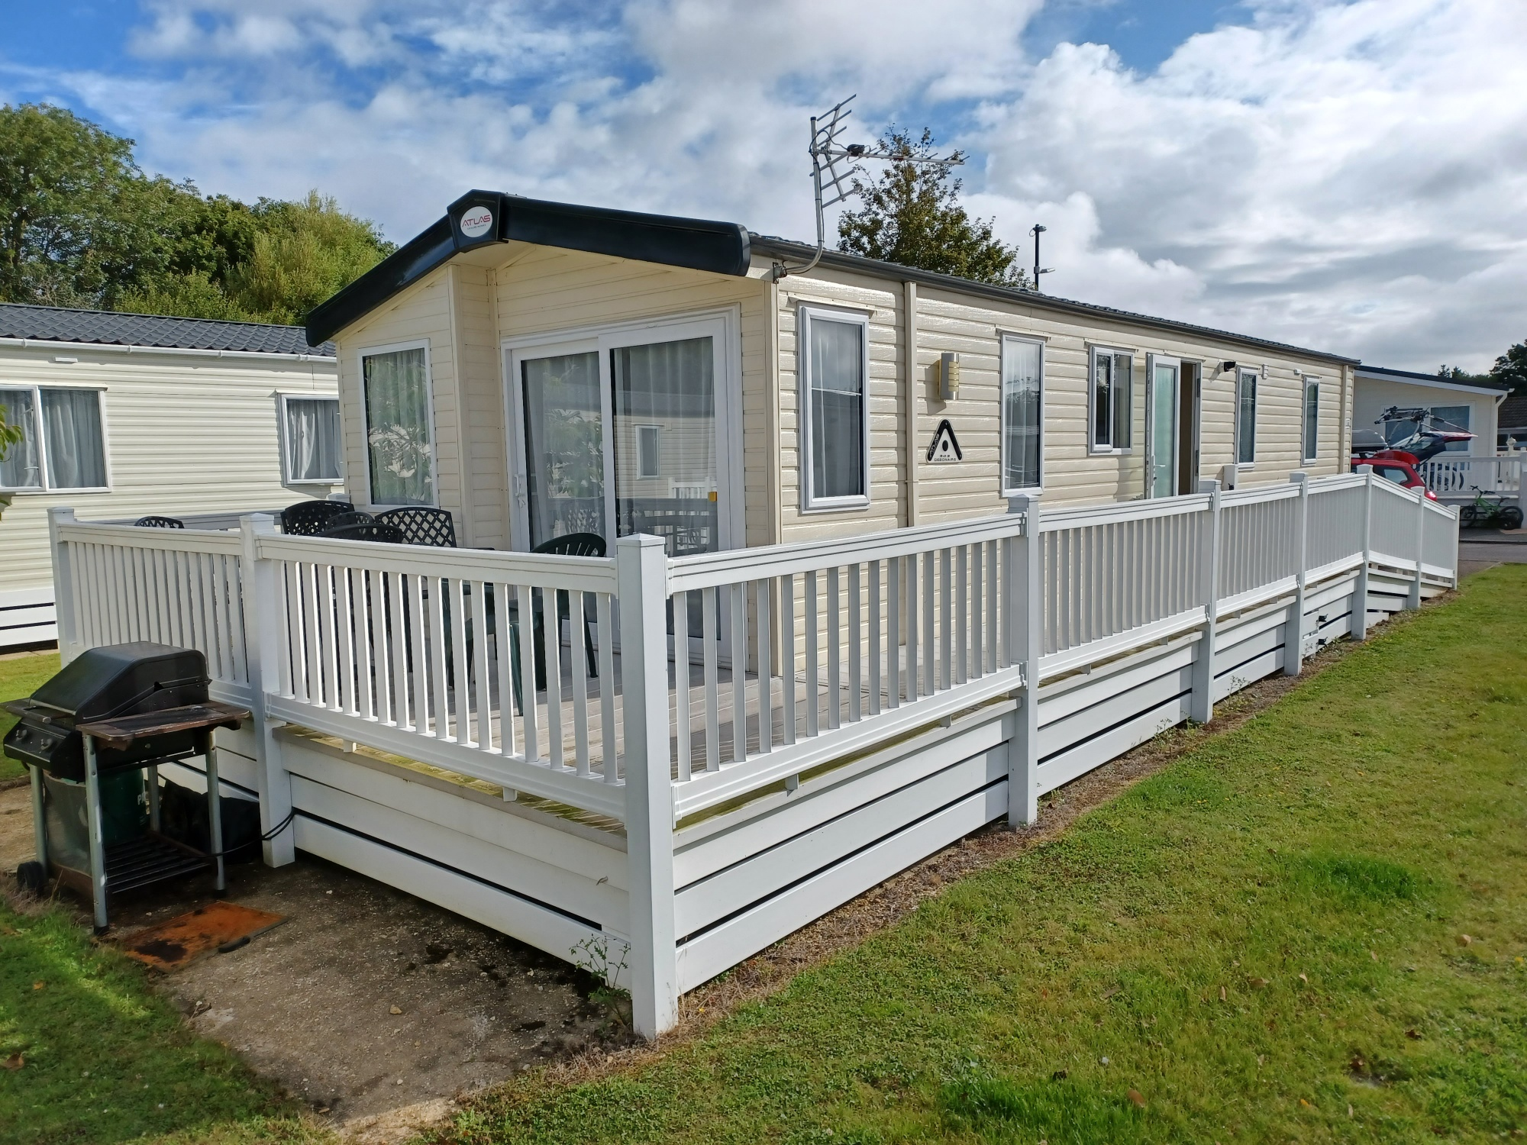
Surrey Police Federation Rest Home at Shorefield Country Park, Milford-on-Sea
Officers and their families requiring rest and relaxation in a stress-free environment following injury, illness
or trauma may have free use of this property and when not being so used any member who contributes to
the Federation Voluntary Fund can hire it for a holiday.
Facilities
Tennis and football courts
Club with Family entertainment
Swimming Pools (indoor/outdoor)
Fitness centre
Reflections Elemis Day Spa*
Jacuzzi, steam room, sauna
Supermarket and launderette*
Children’s outdoor play areas
Amusements* and Crazy Golf*
*charges apply
5 star holiday park
3 miles from the
New Forest National Park and a short walk to the sea
Sleeps 8
3 bedrooms
Terrestrial TV + DVD player
Wi-fi
Microwave, oven + fridge
Fully equipped kitchen
All clean bedding provided
Nearby attractions
Peppa Pig World at Paultons Park
Hurst Castle
Sammy Miller Motorcycle Museum
Appetite for Adventure
Isle of Wight – ferry from Keyhaven
Highcliffe Castle
RSPB Nature Reserves
Exbury Gardens & steam railway
Sherborne Castle
Beaulieu
New Forest activities including:
Canoe tours, kayak tours and hire, archery, Battlefield LIVE, bike hire, ropes and bushcraft
Horse riding stables
Nature trails
Cycle routes
Fishing
Yachting
Surf schools
Golf course
2022 Prices 50% off Shorefield Website prices
2022 Prices 50% off Shorefield webite prices
February to Easter £350
Easter Holidays £550
May half term £650
Easter to June £400
July £600
August £700
Contact Surrey Police Federation Office on:
Tel; 01372 352165
Email: admin@surrey.polfed.org
September to October £400
October Half term £500
November to December £300

